Slide 1
Chapter 2
The Relational Database Model

Slide 2
In this chapter, you will learn:
That the relational database model’s basic components are entities and their attributes, and relationships among entities
How entities and their attributes are organized into tables
About relational database operators, the data dictionary, and the system catalog

Slide 3
Logical View of Data
Relational Database
Designer focuses on logical representation rather than physical
Use of table advantageous
Structural and data independence
Related records stored in independent tables
Logical simplicity
Allows for more effective design strategies

Slide 4
Logical View of Data (con’t.)
Entities and Attributes
Entity is a person, place, event, or thing about which data is collected
Attributes are characteristics of the entity
Tables
Holds related entities or entity set
Also called relations
Comprised of rows and columns

Slide 5
Table Characteristics
Two-dimensional structure with rows and columns
Rows (tuples) represent single entity
Columns represent attributes
Row/column intersection represents single value
Tables must have an attribute to uniquely identify each row
Primary key: attribute and a combination of combined attributes that uniquely identify any given entity (row)

Slide 6
Table Characteristics (con’t.)
Column values all have same data format
Data types:
Number
Character
Date
Logical
Each column has range of values called attribute domain
Order of the rows and columns is immaterial to the DBMS

Slide 7
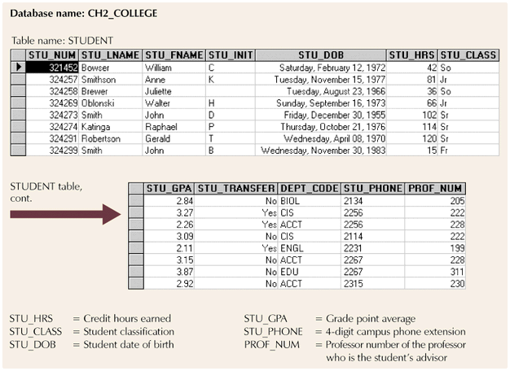
Entity set
Column (attribute)
value
Row
entity

Slide 8
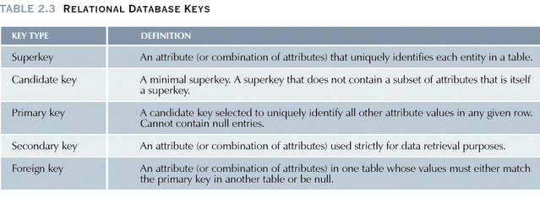

Slide 9
Integrity Rules
Entity integrity
Requirement (Ensures all entities are unique): all primary key entries are unique; no null value
Each entity has unique key
Referential integrity
Foreign key must match primary key values
Makes it impossible to delete row whose primary key has mandatory matching foreign key values in another table

Slide 10
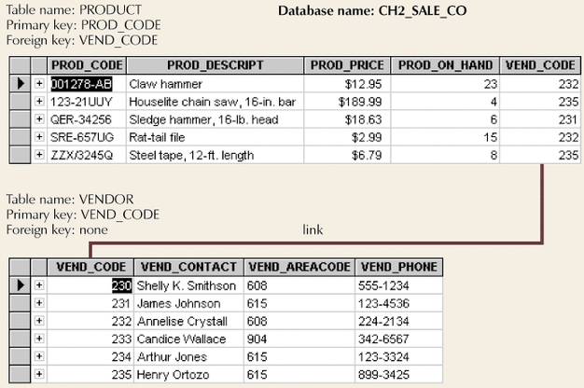
Simple Relational Database
Figure 2.2

Slide 11
Relational Database Operators
Relational algebra defines the theoretical way of manipulating table contents using the eight relational operators, or relational algebra determines table manipulations
Key operators
SELECT
PROJECT
JOIN

Slide 12
Relational Database Operators
Other operators
INTERSECT
UNION
DIFFERENCE
PRODUCT
DIVIDE

Slide 13
UNION
Tables must have the same attribute characters (column and domains must be identical)
That is called these tables are UNION compatible
Combines all rows
Example:

Slide 14
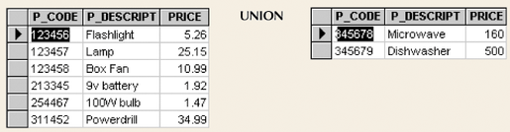
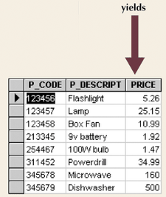
Union
Figure 2.5

Slide 15
Intersect
Tables must be UNION compatible
Yield rows appear in both tables
Example:

Slide 16
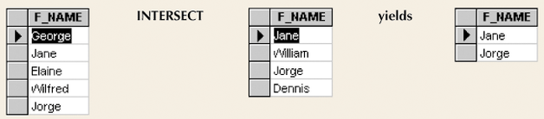
Intersect
Yields rows that appear in both tables
Figure 2.6

Slide 17
Difference
Tables must be UNION compatible
Find rows in table that are not found in the other table.
Example:

Slide 18
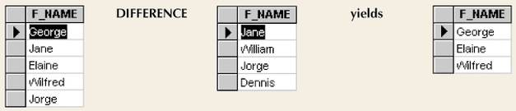
Difference
Yields rows not found in other tables
Figure 2.7

Slide 19
Product
Yields all possible pairs of rows from two tables
Example:

Slide 20
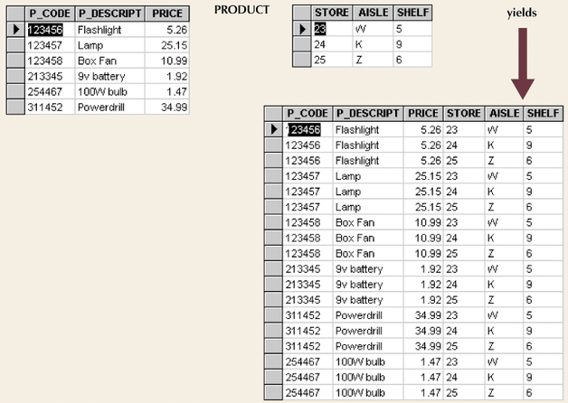
Product
Figure 2.8

Slide 21
Select
Yields values for all rows found in a table.
Select can be used to either list all or list partial rows values that match a specified criterion.
Example:

Slide 22
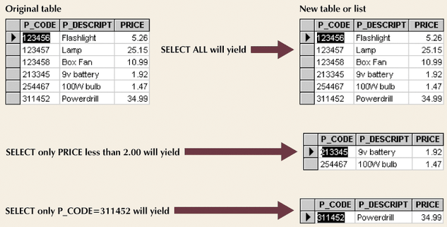
Select

Slide 23
Project
Project yields a vertical subset of a table with selected attributes
Example:

Slide 24
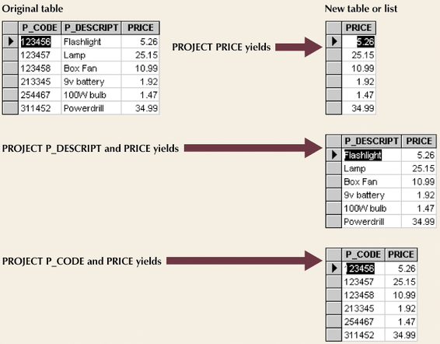
Project
Figure 2.10

Slide 25
Join
Combine information from multiple tables
Natural join process
Product
Select
Project
Example:

Slide 26
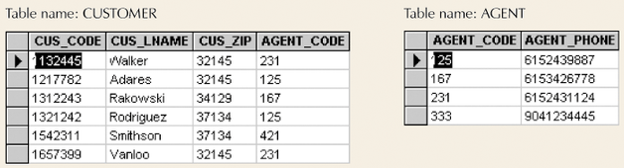
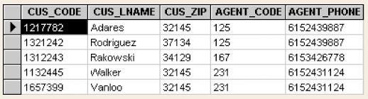
Join
Figure 2.11
Figure 2.14

Slide 27
Natural Join Process
Links tables by selecting rows with common values in common attribute(s)
Three-stage process
Product creates one table
Select yields appropriate rows
Project yields single copy of each attribute to eliminate duplicate columns

Slide 28
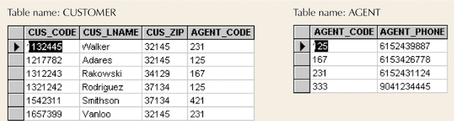
Product Process in Join

Slide 29
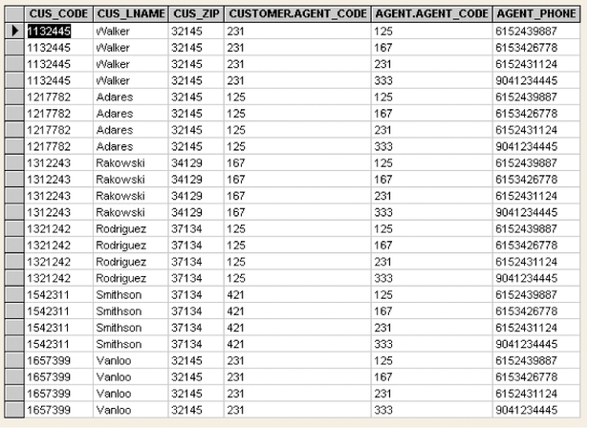

Slide 30
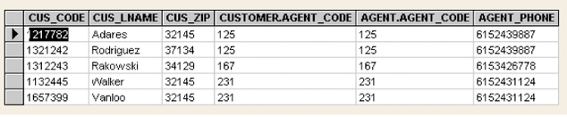
Select Process in Join

Slide 31
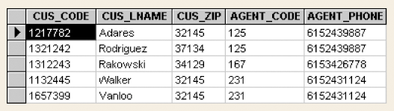
Project Process in Join

Slide 32
Other Joins
EquiJOIN
Links tables based on equality condition that compares specified columns of tables
Does not eliminate duplicate columns
Join criteria must be explicitly defined

Slide 33
Other Joins
EquiJOIN that compares specified columns of each table using operator other than equality one
Theta JOIN
Any other comparison operator is used, it is generally called a theta JOIN

Slide 34
Other Joins
Outer JOIN
Matched pairs are retained
Unmatched values in other tables left null
Right and left outer JOIN
Example:

Slide 35
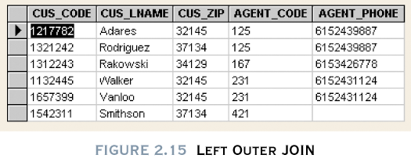

Slide 36
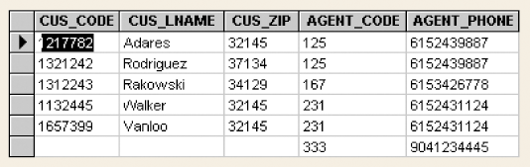

Slide 37
Divide
Use of one single-column table and one two-column table
Find the values associate with A and B Table
Example:

Slide 38
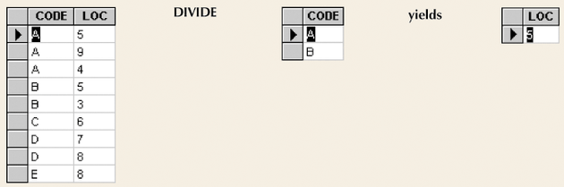
Divide
Requires user of single-column table and two-column table
Figure 2.17

Slide 39
Data Dictionary and System Catalog
Data dictionary
Provides detailed account of all tables found within database
Metadata
Attribute names and characteristics
All members of database design and implementation teams use the same table, attributes and characteristics
DBMS internally store data dictionary and additional information containing relationship types, entity and
referential integrity check and enforcement.
Database designer’s database
System catalog
Detailed data dictionary; current relational database software provides only a system catalog
Data dictionary can be derived from
Stores database characteristics and contents

Slide 40
